Slide 1
Lecture 6: System Testing - Test Selection Techniques
Gregory Gay
DIT636/DAT560 - January 31, 2024

Slide 2
Creating Test Cases
Identify an Independently Testable Function
Identify a function that can be tested in (relative) isolation.
Identify Choices
Identify controllable aspects of the input parameters and environment that determine the outcome of the function.
Identify Representative Input Values
Identify options for each choice that lead to different function outcomes.
Generate Test Case Specifications
Choose a value for each choice to form abstract test case “recipe”.
Generate Test Cases
Replace representative values with concrete values.
Notes:
Last time, we discussed the process of creating System-level tests. As a reminder, this is a five stage process.
You need to figure out what the independently testable functionality of your system or subsystem is. What features or functions are surfaced by an interface and can be tested in isolation. What can we push and observe in the software?
For each of those features, we look at the inputs, configuration options, and execution environment. What can you control when you test this function that would influence the outcome of executing it? This includes both the actual input parameters - what you can pass to the functionality - and any other important aspects you can contorl and that might change the outcome, like database contents or the existence of a file.
For each of those choices, what types of input will trigger each possible outcome. What types of input should we try?
We then combine these representative values to form recipes for test cases, abstract test specifications that state the type of input we will provide. These can lead to many different concrete test cases when we
instantiate the specifications by replacing the abstract representative values with concrete values.

Slide 3

Test Specifications
May end up with thousands of test specifications.
Which do you turn into concrete test cases?
Identify the important interactions between choices.
Notes:
Now, this process leaves you with all of these test specifications, abstract descriptions of test cases you could create. Each of those can lead to hundreds of concrete test cases. This is for ONE high-level function of your software. You clearly can’t try every one of those specifations. Which are important, then? Which should you take and instantiate as concrete test cases? This is something we will explore today. In short, (last)

Slide 4
Today’s Goals
Examine how interactions between choices can lead to failures.
Examine how to select a reasonable subset of test specifications that are likely to detect integration faults.
Category-Partition Method
Combinatorial Interaction Testing

Slide 5
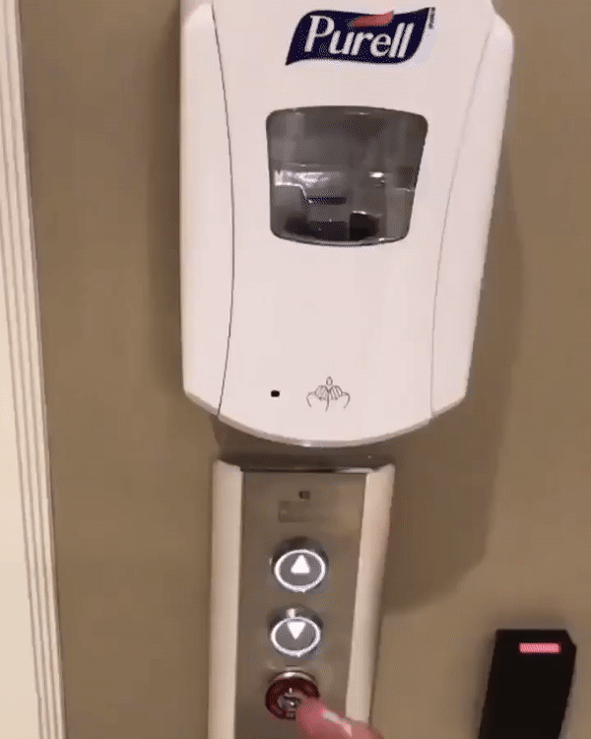
Component Interactions
System components are expected to interact.
Usually this is planned!
Sometimes unplanned interactions break the system.
We should select tests that thoroughly test component integrations.
Notes:
The internal components of your software do not exist in a vacuum. These components - classes, subsystems, services- interact in various ways, both in positive and intended ways, but also in critical and unplanned ways. Components are often expected to interact: to exchange information, to determine the behavior of other features, reuse the functionality of other components, and accomplish a task in cooperation. However, inadvertent interactions can cause unexpected and incorrect behaviors. Detecting and resolving unintended component interactions is one of the key challenges of developing a complex system - and a major point of integration testing- and we want to design our test cases to examine critically important component integrations and have a high chance of detecting these interactions.

Slide 6

Component Interactions
Interactions result from representative values of choices.
Inadvertent interactions cause unexpected behavior
(ex. incorrect output, timing)
Want to detect, manage, resolve inadvertent interactions.
Notes:
A component that works perfectly well in isolation may exhibit inadvertent behavior when combined with other components to perform a higher-level task. The problem is that, when these components are developed independently, it is difficult to predict their mutual interactions when combined. Typically, the behavior of the complete product is not easily deducible from understanding the components in isolation—we have to identify and understand their interactions during system-level testing. An interaction between two or more features, subsystems, or classes is an emergent behavior that cannot be easily predicted from the behaviors associated with the individual features, subsystems or classes involved. An inadvertent interaction occurs when one functionality influences the behavior of another functionality in an unexpected way (regarding the expected execution path through the code, unexpected data changes, changes in timing, or other visible behavior). When we integrate lower-level components, their interactions need to be coordinated, for example, by ordering their execution, synchronizing data access, defining precedence rules for who gets to take an action when, and including missing behavior. Our problem is to detect, manage, and resolve these (inadvertent) interactions. At a high-level, these interactions are triggered by the choices we make when testing. That’s why it’s important to think about the input variables and environment - we want to make sure we identify different ways to manipulate the system in a thorough manner and really trigger the potential ways that interactions can go wrong.

Slide 7

Fire and Flood Control
FireControl activates sprinklers when fire detected.
FloodControl cuts water supply when water detected on floor.
Interaction means building burns down.
Notes:
As an example, consider fire and flood control. In a building-automation system, feature FireControl activates sprinklers when sensors detect a fire, and feature FloodControl cuts off water supply when water is detected on the floor. Individually, both features operate as desired, but they interact in inadvertent and critical ways: When fire is detected, feature FireControl activates sprinklers; sub- sequently, feature FloodControl detects standing water, and turns off the water main; as a consequence, the building burns down. Clearly, the interaction between FireControl and FloodControl is undesired, and inadvertent in the sense that it is hard to predict when planning and implementing the involved features independently. Only when the interaction is known, we can take corresponding steps to manage or resolve it, in this case, for example, by giving explicit priority to feature FireControl over feature FloodControl, controled by some coordination code.

Slide 8
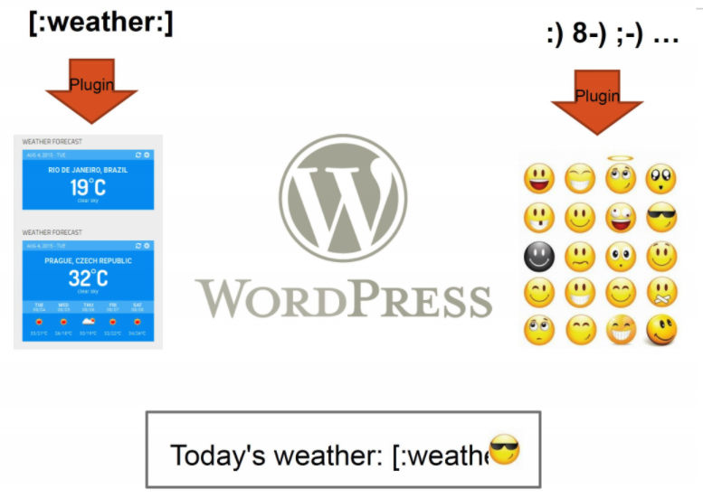
WordPress Plug-Ins
Weather and emoji plug-ins tested independently.
Their interaction results in unexpected behavior.
Notes:
Or, consider WordPress plug-ins. We have a plug-in that turns symbols into emoji. We also have a plugin that lets us insert a forecast widget into a post. Weather is activated using [:weather:]. However, :] is also an emoji. In isolation, each works really well. Each has been fully tested, and works as expected. When we combine them, we get unexpected behavior. The emoji plug-in activates first, turning :] into a smiling emoji. This then breaks the weather plug-in because it no longet sees the weather command. If the ordering was reversed, it would work just fine. However, these two plug-ins were developed independently and never tested together - why would they be? As a result, we get an unexpected interaction.

Slide 9


Component Interactions
Notes:
I promised memes, right? These illustrate pretty succinctly how features can interact in unexpected ways even after you test each in isloation. On the left, a perfectly functional door lock on a perfectly functional sliding door. In isolation, great. Combined, that lock doesn’t do a bit of good. On the right, two windows. Each would work on their own, but in combination, they block each other. This illustrates why unit testing is crucially important, but so is system-level testing. Unit testing will completely miss how these features interact. These examples show the breadth of possible feature interactions. Some feature interactions are undesired and inadvertent in the sense that they are hard to predict when planning and implementing features in isolation. Other feature interactions are desired and planned in advance. In any case, features need to be coordinated (more or less explicitly), and that may require additional coordination code to make them work together. That also means feature interactions may harm feature modularity, because, besides the fact that each feature has its own code, there is additional code that does not belong to a single feature, but to a combination.

Slide 10
Selecting Test Specifications
We want to select specifications likely to expose interaction faults.
Category-Partition Method
Apply constraints to reduce the number of specifications.
Combinatorial Interaction Testing
Identify a subset that covers all interactions between pairs of choices.
Notes:
Now we are back to the problem of how to select interesting test specifications. We want the ones more likely to result in errors, and we want to ignore specifications that are not likely to tell us anything interesting. We’re going to talk about two approaches to control that set, and these two can even be combined. (go over)

Slide 11
Category-Partition Method
Notes:
So, how do we select the right feature interactions this when testing? There are two techniques we will cover, which are complementary. The first is called the category-partition method, and it is just a simple extension on the exact same process we talked about last class.

Slide 12
Category-Partition Method
Creates a set of test specifications.
Choices, representative values, and constraints.
Choices: What you can control when testing.
Representative Values: Logical options for each choice.
Constraints: Limit certain combinations of values.
Apply more constraints to further limit set.
Notes:
(title) is A method of generating test specifications from requirement specifications that is basically the same process we already talked about with the addition of a set of constraints used to limit the size of the set of test specifications. For an independently testable function, you identify (2). Choices and representative values are things we covered last time. Choices are what you control when testing - the types of values you can feed a parameter, the variants you choose at variation points in your feature model, and additional environmental factors that can influence the outcome of the function. Then, you identify representative values for each choice. Divide the input space up into logical partitions based on the outcomes they can trigger in the function. The new element here are the constraints. Three types of constraints - called if-constraints, error constraints, and single constraints, are used to control the number of test case specifications that you need to create concrete test cases for. once you have these categories, choices, and constraints, you can use them to estimate the number of test cases that you’ll need to create, and (last point). This lets you work your way down to a set that is reasonable to spend human effort creating. if you end up with too many test cases that need to be created, you can apply more constraints until you get a reasonably sized test suite.

Slide 13
Identify Choices
Examine parameters of function.
Direct input, environmental parameters (i.e., databases), and configuration options.
Identify characteristics of each parameter.
What aspects influence outcome? (choices)
Notes:
So, we start, as before, by (read title). So, just like before, you’ll (read 1). This includes not just the direct input parameters, but the environmental parameters like databases or hardware, and configurations options as well - what do we control, and what from that can affect the outcomes. What input, explicit and input, do we provide to that function? Then, we should think about what defines each parameter. (4) These are the choices in our test creation method, right? what are the factors that you control when testing that determine the outcome of a function. They may not reflect something that can be set in the code, but rather may be something test or outcome specific that you can control and that influence several of the variables in the code (last point). However, I am going to use the term choices to keep consistency with last class.

Slide 14
Example - Set Functions
Small function library related to Sets:
POST /insert/SETID {“object”: VALUE}
Returns { “result”: VALUE (“OK” if success or error)}
GET /find/SETID {“object”: VALUE}
Returns { “result”: VALUE (TRUE or FALSE)}
GET /delete/SETID {“object”: VALUE}
Returns { “result”: VALUE (“OK” if success or error)}
We want to write tests for these three functions.
Notes:
As a running example, let’s consider a situation where you have developed a small library of functions related to maintaining a Set datastructure. It offers three methods, and the datastructure itself. Those methods are (go over)

Slide 15
Example - Set Functions
Identify an Independently Testable Function
POST /insert/SETID {“object”: VALUE}
What are our choices?
Identify Choices
// Set up the existing set, either empty or with items.
POST /insert/ {“set”: [ …]}
// Insert an object
POST /insert/SETID {“object”: VALUE}
// Check the result
pm.test(“Insertion”, function() {
var jsonData = pm.response.json();
pm.expect(jsonData.result).to.eql(VALUE);});
Parameter: Set ID
Choice 1: How many items are in the set? (performance may degrade with larger sets)
Parameter: Object
Choice 2: Is obj already in the set?
Choice 3: Is the object valid? (e.g., not null)?
Notes:
insert is one of our indepedently testable functions. We want to test it. To do so, we need to identify what we control when we test. It may help to look first at what a test might look like for this method (go over). Ok - what do we control when testing this function?
(click to bring in choices)

Slide 16

Identify Representative Values
Many values can be selected for each choice.
Partition values into equivalence classes.
Sets of interchangeable values.
Consider all outcomes of function.
Consider logical ranges or groupings.
A test specification is a selection of values for all choices.
Concrete test case replaces equivalence class with a concrete value.
Notes:
Again, just like last time, we now want to form test specifications by coming up with representative values for each choice. (1) Especially if these correspond to input variables for the system, we may have a near-infinite number of poosible selections for each choice. we need to look at each choice and (read 2). consider the different outcomes of a function. Especially the error-handling cases, and make sure you try all of those variations out to make sure nothing bad sneaks through. Also (4), that you could break the variable down into that may lead to minor variations in the outcomes. Take, for instance, an integer and look at how different broad values of that integer can lead to different outcomes. Then, (last two)

Slide 17
Example - Set Functions
Identify Representative Input Values
POST /insert/SETID {“object”: VALUE}
Parameter: Set ID
Choice: How many items are in the set?
Representative Values:
Empty Set
Set with 1 item
Set with 10 items
Set with 10000 items
Parameter: object
Choice: Is the object already in the set?
Representative Values:
obj already in set
obj not in set
Choice: Is the object valid?
Representative Values:
Valid obj
Null obj
Notes:
go over representative values

Slide 18
Generate Test Case Specifications
Test specification = selection a values for each choice.
Constraints limit number of specifications.
Eliminate impossible pairings.
Remove unnecessary options.
Choose a subset to turn into concrete tests.
7776 tests (all combinations)
40 tests (after constraints)
Notes:
-(1). So, at the base level, the number of possible test specifications is the cartesian product of the number of representative values for all choices. Now, the number of combinations of abstract test specifications grows exponentially as the number of choices and representative values for each grows. For example, for a simple system with five choices and six values for each, the raw number of test specifications is 6^5, or 7776. Which, is an insane number of tests for a simple function. - That said, we still don’t need all of those. Many of those combinations may not even be possible, so that is where the idea of constraints comes into play. You want to eliminate any combinations that are impossible, identify constraints that can be used to remove unnecessary combinations, and from the remainder, choose a practical subset to test the system with then (last)

Slide 19
Example - Set Functions
Generate Test Case Specifications
Set Size | Obj in Set | Obj Status | Outcome
Empty | Yes | Valid | No change
Empty | Yes | Null | Error
Empty | No | Valid | Obj added to Set
Empty | No | Null | Error
1 item | Yes | Valid | No change
1 item | Yes | Null | Error
1 item | No | Valid | Obj added to Set
1 item | No | Null | Error
10 items | Yes | Valid | No change
10 items | Yes | Null | Error
10 items | No | Valid | Obj added to Set
10 items | No | Null | Error
POST /insert/SETID {“object”: VALUE}
(4 * 2 * 2) = 16 specifications
Each can become 1+ tests.
Use constraints to remove impossible combinations.
Set Size | Obj in Set | Obj Status | Outcome
10000 | Yes | Valid | No change (may be slowdown)
10000 | Yes | Null | Error
10000 | No | Valid | Obj added to Set(may be slowdown)
10000 | No | Null | Error (may be slowdown)
Notes:
From this, we can form 16 test specifications by choosing values for each choice. now, of course, many of these are redundant or impossible, so we can eliminate ones that we don’t really expect to learn anything new from or that can’t be run. We identify those next through constraints. For now, Here is our set of test specifications, our recipes for test cases. (go over)

Slide 20
Constraints Between Choices
IF-CONSTRAINT
This representative value can only used if a certain value is used for a second choice (if Choice 1 == X, Choice 2 can be Y)
ERROR
Selected representative value causes error regardless of values selected for other choices.
SINGLE
Only a single test with this representative value is needed.
Corner cases that should give “good” outcome.
Notes:
There are three types of constraints that we can define to reduce the number of pairings.
-(1-2) for instance, you might choose a value for one choice only if a particular value is used for another choice.
-(3-4) so we don’t need every combination of values for all choices that include this particular value Just one test with this error-inducing value should be enough for us.
- (5-6) Single is similar to error, but more general purpose. A value is special or unusual in some way, but should still give us a “good” normal outcome. So we want totry it once just to be sure. However, we don’t need every combination of other values for other choices with this one value for this one choice. We just need one test that uses this particular value and we can move on.

Slide 21
Example - Substring
substr(string str, int index)
Choice: Str length Choice: index
length = 0 value < 0
length = 1 value = 0
length >= 2 value = 1
Choice: Str contents value > 1
contains letters and numbers
contains special characters
empty
property zeroLen
ERROR
if !zeroLen
if !zeroLen
SINGLE
if zeroLen
Notes:
Let’s take a simple example, a substr function. Takes in a string and an index and returns everything from the start of the string to that index. For each choice, we have some representative values (go over)
What are some of the constraints we can try applying? (discuss)
(click)- prop/if read
(click)- error
(click)- single - this one shouldn’t result in an error, but werid things could happen. We only really need to try it out once. It should execute and work,. So, let’s try it once

Slide 22
Example - Set Functions
Identify Constraints
POST /insert/SETID {“object”: VALUE}
Parameter: set
Choice: How many items are in the set?
Representative Values:
Empty Set
Set with 1 item
Set with 10 items
Set with 10000 items
Parameter: obj
Choice: Is the object already in the set?
Representative Values:
obj already in set
obj not in set
Choice: Is the object valid?
Representative Values:
Valid obj
Null obj
property empty
if !empty
single
single
error
Notes:
Or, let’s go back to our insert function. What are some possible constraints here. (click) If the set is empty, then the object can’t already be in the set. (click) If we have a null object, that always leads to an error regardless of what it is paired with. We can just have one test case with that value and ignore the other combinations (click) We are concerned with the set size for performance reasons. We want to see how performance changes as the number of items increases. So, we could mark these as “single” cases. They should work - we should get the same outcome as the “1 item” case, we just want to see if it gets slower. So, we can try one test case for each just to see the outcome, and not test all combinations with these.

Slide 23
Example - Set Functions
Apply Constraints
Set Size | Obj in Set | Obj Status | Outcome
Empty | Yes | Valid | No change
Empty | Yes | Null | Error
Empty | No | Valid | Obj added to Set
Empty | No | Null | Error
1 item | Yes | Valid | No change
1 item | Yes | Null | Error
1 item | No | Valid | Obj added to Set
1 item | No | Null | Error
10 items | Yes | Valid | No change
10 items | Yes | Null | Error
10 items | No | Valid | Obj added to Set
10 items | No | Null | Error
POST /insert/SETID {“object”: VALUE}
(4 * 2 * 2) = 16 specifications
Can’t already be in empty set, - 2
error (null), - 6
single (10, 10000), - 2
Set Size | Obj in Set | Obj Status | Outcome
10000 | Yes | Valid | No change (may be slowdown)
10000 | Yes | Null | Error (may be slowdown)
10000 | No | Valid | Obj added to Set(may be slowdown)
10000 | No | Null | Error (may be slowdown)
Notes:
Let’s apply these constraints and see what is left.(click) First, we can’t have an object already in the set if the set is empty. That removes two (click) Next, we have the error - the null object being inserted. We only need to keep one case of this. It makes sense to just keep the empty list one. Especially as we can’t have a case of it already in the set if it is null. That removes another six. (click) Now, we have the two single constraints. We only need one test case with 10 items and one with 10000 items to test performance. We don’t need all combinations. Let’s keep the ones where we actually insert it in the set. From the remaining 8 test cases, we can remove another two. That leave us with a nice small set of 6 test cases from the original 16.

Slide 24
Example - Set Functions
Apply Constraints
POST /insert/SETID {“object”: VALUE}
From 16 -> 6 specifications
Each can become 1+ tests.
Can further constrain if needed.
Set Size | Obj in Set | Obj Status | Outcome
Empty | No | Valid | Obj added to Set
Empty | No | Null | Error
1 item | Yes | Valid | No change
1 item | No | Valid | Obj added to Set
10 items | No | Valid | Obj added to Set
10000 | No | Valid | Obj added to Set(may be slowdown)
Notes:
That leave us with a nice small set of 6 test cases from the original 16. (points 2-3)

Slide 25
Example - Set Functions
Create Test Cases
POST /insert/SETID {“object”: VALUE}
Set Size | Obj in Set | Obj Status | Outcome
Empty | No | Valid | Obj added to Set
Set Size | Obj in Set | Obj Status | Outcome
Empty | No | Null | Error
// Set up empty set.
POST /insert/ {“set”: []}
// Insert a valid object
POST /insert/SETID {“object”: “Test”}
// Check the result
pm.test(“Valid Insert”, function() {
var jsonData = pm.response.json();
pm.expect(jsonData.result).to.eql(“OK”);});
// Set up empty set.
POST /insert/ {“set”: []}
// Insert a null object
POST /insert/SETID {“object”: null}
// Check the result
pm.test(“Null Insert”, function() {
var jsonData = pm.response.json();
pm.expect(jsonData.result).to.eql(“Null object cannot be inserted into set”);});
Notes:
Finally, to make this a little more solid, here is what a concrete test case might look like for a couple of test specifications (go over)

Slide 26
Activity - find service
find(pattern,file)
Finds instances of a pattern in a file
find(“john”,myFile)
Finds all instances of john in the file
find(“john smith”,myFile)
Finds all instances of john smith in the file
find(““john” smith”,myFile)
Finds all instances of “john” smith in the file
Notes:
Let’s do an example together now.

Slide 27
Activity - find Service
Parameters: pattern, file
What can we vary for each?
What can we control about the pattern? Or the file?
What values can we choose for each choice?
File name:
File exists with that name
File does not exist with that name
What constraints can we apply between choice values? (if, single, error)
Notes:
(go over) Give time to work on

Slide 28
Let’s take a break.
Notes:
10 minute break while thinking, open drawing document to do together

Slide 29
Example - find Service
Pattern:
Pattern size:
Empty
single character
many characters
longer than any line in the file
Quoting:
pattern has no quotes
pattern has proper quotes
pattern has improper quotes (only one “)
Embedded spaces:
No spaces
One space
Several spaces
(2²*3³*4¹) = 108 test specifications
File:
File name:
Existing file name
no file with this name
Number of occurrence of pattern in file:
None
exactly one
more than one
Pattern occurrences on any single line line:
One
more than one
Notes:
Go over
How many combinations - test specifications - 108 (two variables with two options, three with three, one with four. Niot too horrible, but still a lot for one function. Let’s constraint it.

Slide 30
ERROR and SINGLE Constraints
File name:
Existing file name
no file with this name
Number of occurrence of pattern in file:
None
exactly one
more than one
Pattern occurrences on target line:
One
more than one
Pattern size:
Empty
single character
many character
longer than any line in the file
Quoting:
pattern has no quotes
pattern has proper quotes
pattern has improper quotes (only one “)
Embedded spaces:
No spaces
One space
Several spaces
4 (error) + 2 (single) + (1²*2³*3¹) = 30
[error]
[error]
[error]
[single]
[error]
[single]
Notes:
Let’s narrow further. Can we apply any error constraints?
- go over. Now, anything we can try just once and leave out after?
- go over. How many tests now? 30! Much better shape, and down from our starting point of 108

Slide 31
IF Constraints
File name:
Existing file name
no file with this name
Number of occurrence of pattern in file:
None
exactly one
more than one
Pattern occurrences on target line:
One
more than one
Pattern size:
Empty
single character
many character
longer than any line in the file
Quoting:
pattern has no quotes
pattern has proper quotes
pattern has improper quotes (only one “)
Embedded spaces:
No spaces
One space
Several spaces
4 (error) + 2 (single) + (1³*2³) (quoted = true) + (1⁴*2²) (quoted = false) = 18
[error]
[error]
[error]
[single]
[property quoted]
[error]
[single]
[if quoted]
[if quoted]
Notes:
let’s add a constraint. (go over quoted)

Slide 32
Combinatorial Interaction Testing
Notes:
The second technique is called combinatorial interaction testing. It is complementary to the last approach. We take a pool of test specifications, possible filtered using category partition technique already, and the then try to identify a small pool of tests that cover all n-way (generally 2-way) feature interactions.

Slide 33
Limiting Num. of Test Specifications
Choice: Bandwidth Mode | Choice: Language | Choice: Fonts
Desktop Site | English | Standard
Mobile Site | French | Open-Source
Text Only | German | Minimal
 | Swedish
Choice: Advertising | Choice: Screen Size
No Advertising | Phone
Targeted Advertising | Tablet
General Advertising | Full Size
Minimal Advertising
Full set = 432 specifications
Few natural IF, SINGLE, ERROR constraints for these features.
What is important to cover?
Notes:
The category-partition method allows the test designer to add constraints that limit growth in the number of combinations. This can be a reasonable approach when the constraints come naturally from the application domain, and eliminate many redundant combinations (like the “error” entries). It doesn’t work if you lack real constraints from the application domain,and the test designer is forced to add arbitrary constraints whose sole purpose is to reduce the number of combinations. Consider the set of features that control the appearance of our web site, shown here on this slide. Exhaustive enumeration produces 432 combinations, which is too many for one feature. WE could hypothesize some constraints, such as text only mode is limited to phones, but radical reductions require adding several “single” and “property” constraints without any real rationale. So, what can we do with this?

Slide 34
Combinatorial Interaction Testing
Cover all 2-way (pairwise) interactions.
Can cover multiple pairs of representative values for choices with one test case.
Set of all combinations grows exponentially.
Set of pairwise combinations grows logarithmically.
(last slide) 432 combinations.
Possible to cover all pairs of representative values in 16 tests.
Notes:
When it is reasonable to expect some potential interaction between features, but covering all combinations is impractical, a reasonable alternative is to cover all pairwise choice interactions instead of all possible interactions. One test case is a selection of values for each choice, so one test case can cover multiple PAIRS of choice interactions. We have already observed that the number of possible interactions is the product of the number of values for each choice, and that this product grows exponentially with the number of choices. It turns out that the number of combinations needed to cover all possible pairs of values grows only logarithmically with the number of choices — an enormous savings in effort. (last two points)

Slide 35
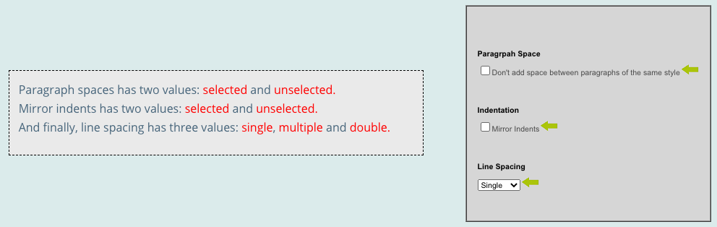
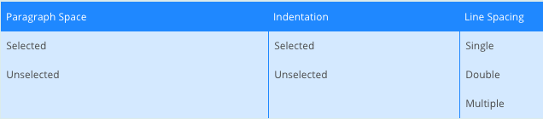
Example - Paragraph Effects
2 * 2 * 3 = 12 combinations
Notes:
Let’s look at an example of how we do this. Let’s say we can control how we display paragraphs in a document. We have three choices. (go over)
SO, 2 * 2 * 3 = 12 possible combinations. Not too bad, but we can shrink this. The key is to look at interactions between subsets of these choices.

Slide 36
Example - Paragraph Effects
Look at how any two of the three choices interact.
Paragraph spacing and line spacing
Paragraph spacing and indentation
Indentation and line spacing
Many faults due to interaction of two features, not all three at once.

Slide 37
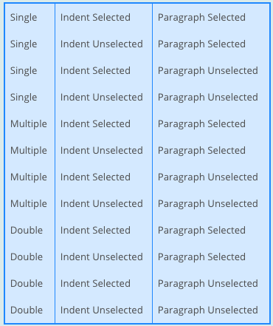
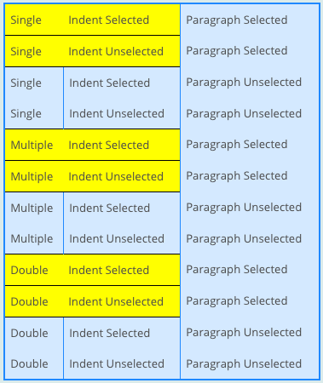
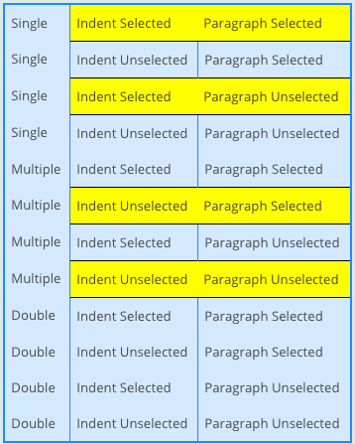
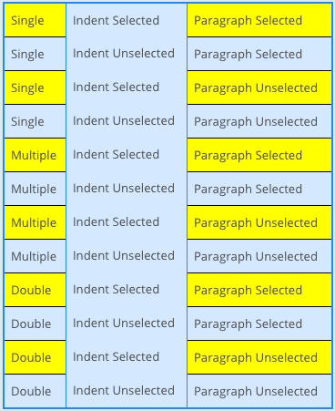
Example - Paragraph Effects
Notes:
Here is the enumerated list of all possible specifications.Instead of checking all specification we can look at only these 2-way (pairwise) combinations. Focusing on covering those will discover almost all faults in fewer specifications (click) First we look at all the combinations of values between line spacing and indent selection. (go over) (click) Next we examine the combinations of values between indent selection and paragraph selection. (go over) (click) Finally we look at the combinations of values between line spacing and paragraph selection. (go over) You will notice then, that many of these overlap and two are never used at all. If we’re careful, we can get this down to six specifications that cover all of these pairs instead of needing to cover all 12 specifications.

Slide 38
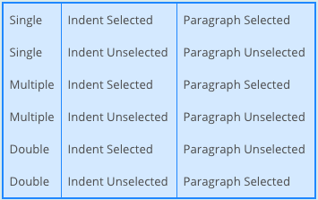
Example - Paragraph Effects
Goal of CIT is to produce covering array.
Subset of configurations that covers all 2-way combinations.
Cover in 6 test cases.
Notes:
By eliminating the configurations that repeat already tested pairwise combinations and some simple shuffling around you can create this array of 6 different configurations that covers all pairwise (2-way) combinations of input. This is what we call a covering array, a set of value selections for our choices that covers all - in this case - 2-way interactions. The goal of CIT is to create the smallest covering array we can. In this case, we can reduce from 12 down to 6 test specifications. In this small example it wasn't too difficult to create the pairwise covering array by hand, however when dealing with systems that thousands or even hundreds of configurations this is difficult. However, this not often something you do by hand and there are methods of generating small covering arrays that you can get, including tools from Microsoft, IBM, and others that attempt to generate covering arrays. However, today, let’s go through in more detail how you would do this yourself for small programs.

Slide 39
Example - Website Display
Choice: Bandwidth Mode
Desktop Site
Mobile Site
Text Only
Choice: Fonts
Standard
Open-Source
Minimal
Choice: Screen Size
Phone
Tablet
Full Size
Bandwidth Mode | Fonts
Desktop Site | Standard
Desktop Site | Open-Source
Desktop Site | Minimal
Mobile Site | Standard
Mobile Site | Open-Source
Mobile Site | Minimal
Text Only | Standard
Text Only | Open-Source
Text Only | Minimal
Screen Size
Phone
Tablet
Full Size
Tablet
Full Size
Phone
Full Size
Phone
Tablet
Cover all combinations for two variables.
Add a third, account for all combinations of pairs of values.
Each test specification can cover up to three pairs.
Notes:
Let’s take our website example again, and start with just three variables - Bandwidth mode, Screen size, and Fonts. Three variables, three values. In total, 27 test combinations. We can cover in fewer, though, as we just saw. (click) We can start with only the first two, bandwidth mode and fonts, the set of all pairs and the set of all combinations for that are the same, 3*3 = 9 combinations (go over). When we add the third parameter, screen size, generating all combinations requires combining each value class from screen size with every pair of bandwidth mode×fonts, a total of 27 combinations. However, if we are generating pairs of values from bandwidth mode, screen size, and fonts, we can add value classes of screen size to existing elements of bandwidth mode×font in a way that covers all the pairs of fonts×screen size and all the bandwidth mode×screensize without increasing the number of combinations at all. (click) The key is that each combination of three elements contains three pairs, and by careful selecting values we can make each combination cover up to three different pairs (go over) (see if there are questions)

Slide 40
Example - Website Display
Language | Advertising
English | No Advertising
English | Targeted Advertising
English | General Advertising
English | Minimal Advertising
French | No Advertising
French | Targeted Advertising
French | General Advertising
French | Minimal Advertising
German | No Advertising
German | Targeted Advertising
German | General Advertising
German | Minimal Advertising
Swedish | No Advertising
Swedish | Targeted Advertising
Swedish | General Advertising
Swedish | Minimal Advertising
Bandwidth Mode
Desktop Site
Mobile Site
Text Only
-
-
Desktop Site
Mobile Site
Text Only
Text Only
-
Desktop Site
Mobile Site
Mobile Site
Text Only
-
Desktop Site
Fonts
Standard
Open-Source
Minimal
Minimal
-
Minimal
Standard
Open-Source
Minimal
-
Open-Source
Standard
Open-Source
Standard
-
Minimal
Screen Size
Phone
Tablet
Full Size
Phone
-
Full Size
Tablet
Phone
Tablet
-
Phone
Full Size
Full Size
Phone
-
Tablet
Choice: Bandwidth Mode | Choice: Language | Choice: Fonts
Desktop Site | English | Standard
Mobile Site | French | Open-Source
Text Only | German | Minimal
 | Swedish
Choice: Advertising | Choice: Screen Size
No Advertising | Phone
Targeted Advertising | Tablet
General Advertising | Full Size
Minimal Advertising
Mobile Site
Notes:
Let’s extend this now to the full set. Five choices. Two with four options, and three with three = 432 combinations, but we can do it in less. Again, start with two variables. Start with the ones with the most options. In this case, we have two with four choices (click) So, 16 combinations (4x4). (go over) Now, we want to add a third. The rest all have three values, so add any of those. We will add bandwidth mode (click) Here, we want to again try to match all combinations with the previous two. (go over). Now, there are fewer values for this variable, so you’ll notice some dashes. These are cases where we don’t really care what value we pick. We might need to fill in some of these later on, but for now, they could be any combination. (click) Now, we bring in the fourth, fonts. (click) Now, here we need to go back and fill in a “don’t care” for bandwidth mode to get a “mobile” interaction with minimal. Finally, we add that fifth, screen size (click) Here, we don’t need to set any more don’t care values to get all combinations in. So, we can do this in 16 tests. Way better than 432! We might still miss issues with higher-order feature interactions, but all 2-way interactions - which are the most common source of problems - will be caught this way.

Slide 41
Activity - Browser Configuration
Choice: Allow Content to Load | Choice: Notify About Pop-Ups | Choice: Allow Cookies | Choice: Warn About Add-Ons | Choice: Warn About Attack Sites | Choice: Warn About Forgeries
Allow | Yes | Allow | Yes | Yes | Yes
Restrict | No | Restrict | No | No | No
Block |  | Block
Choices and Representative Values
Full set of test specifications = 144
Create set covering all pairwise value combinations.
Hint: Start with two variables with most values. Add one variable at a time.
Notes:
let’s do one more example interactively. You are designing system-level tests for a web browser with multiple configuration options. You have extracted the following choices, with the following representative values for each: (go over) The full set of possible test specifications contains 144 options. Create a covering array of specifications that covers all pairwise value combinations in fewer test specifications. (hint: start with two variables with the most values and add additional variables one at a time)

Slide 42
Activity Solution
Allow Content | Allow Cookies
Allow | Allow
Allow | Restrict
Allow | Block
Restrict | Allow
Restrict | Restrict
Restrict | Block
Block | Allow
Block | Restrict
Block | Block
Add-Ons
Yes
No
-
No
-
Yes
-
Yes
No
Forgeries
Yes
No
Yes
No
Yes
No
Yes
-
No
Pop-Ups
Yes
No
-
-
Yes
No
No
-
Yes
Attacks
Yes
Yes
No
No
-
Yes
-
No
Yes
No
No
Yes
Notes:
start with the two variables with three values (click) now add any of the two value ones , pop-ups (go over) (click) add-ons(click) attachs - need to fill in some of those values (click) forgeries, can do without filling anything (ask questions?)
From 144 to 9 test cases. Yours might look a little different

Slide 43
CIT Tools
Pairwise Independent Combinatorial Testing (Microsoft): https://github.com/microsoft/pict
Automated Combinatorial Testing for Software (NIST): https://csrc.nist.gov/projects/automated-combinatorial-testing-for-software
.. Many more: http://www.pairwise.org/tools.asp

Slide 44
We Have Learned
Two methods that identify important representative value interactions:
Category-Partition Method: Use constraints to eliminate unnecessary tests.
Combinatorial Interaction Testing: Identify important pairs of input values.
Notes:
(read)

Slide 45
Next Time
Exercise Session:
Practice in system-level test design.
Next Tuesday:
Exploratory Testing
Assignment 1 - Feb 11
All topics now covered.
Any questions?

